Slide 1
Chapter 12
Impact Analysis

Slide 2
Overview
Impact Analysis (Reason, Traceability, Ripple Effect)
Impact analysis process
Dependency based impact analysis
Ripple Effect
Change Propagation Model

Slide 3
Impact Analysis
Structured process of evaluating the potential direct and indirect consequences of a proposed change before it is implemented.
It helps organizations understand how modifications – whether in software, business processes, or project workflows – might affect existing systems, resources, and stakeholders.

Slide 4
Importance of Impact Analysis
Risk Mitigation: Identifies potential issues early, preventing disruptions and costly errors.
Cost Efficiency: Reduces waste by optimizing resources and avoiding unnecessary expenditures.
Strategic Decision-Making: Offers data-driven insights to align changes with business goals.
Regulatory Compliance: Ensures adherence to industry standards and legal requirements.
Stakeholder Confidence: Builds trust by demonstrating a proactive approach to change management.

Slide 5
Impact Analysis and Ripple effect
Ripple effect means that a modification to a single variable may require several parts of the software system to be modified. The concept of ripple effect has relevance in software evolution because it concerns changes and their effects
Measurement of ripple effects can provide the following information about an evolving software system:
(i) between successive versions of the same system, measurement of ripple effect will tell us how the software’s complexity has changed;
(ii) when a new module is added to the system, measurement of ripple effect on the system will tell us how the software’s complexity has changed because of the addition of the new module.

Slide 6
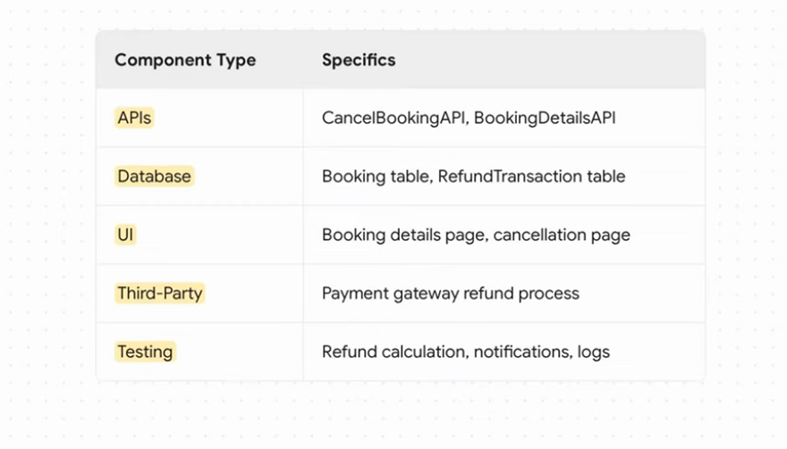
Ripple Effect Example: Hotel Booking System
You want to make change the cancellation policy logic for hotel bookings

Slide 7
Impact Analysis Methods
Traceability impact analysis: Used to find out/explore the relationships between different product components.
Dependency impact analysis: Examines dependencies, the effects that a change may have on the entire system, not on a specific area.
Experimental impact analysis: Based on past similar impact patterns to predict the impact of future changes.

Slide 8
Impact Analysis Process
Gather a team
Brainstorm
Evaluate
Report findings
Make adjustments
Implement the change

Slide 9
Traceability impact analysis
Traceability is the ability to trace between software artifacts generated and modified during the software product life cycle.
Helps software developers understand the relationships among all the software artifacts in a project.
There are two broad kinds of traceability - horizontal (external) traceability and vertical (internal) traceability.
Traceability of artifacts between different models is known as external traceability, whereas internal traceability refers to tracing dependent artifacts within the same model. Internal traceability primarily focuses on source code artifacts.

Slide 10
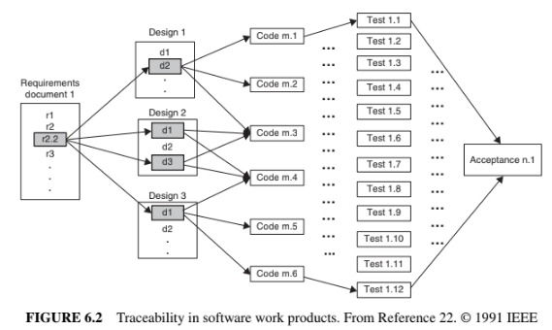
Analysis of Traceability Graph

Slide 11
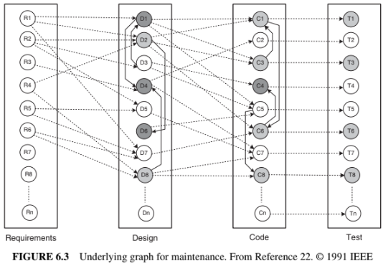
Analysis of Traceability Graph

Slide 12
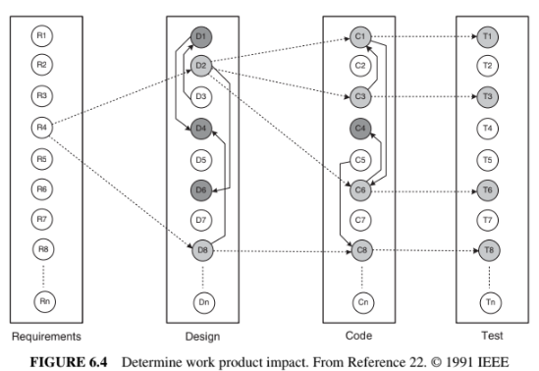
Analysis of Traceability Graph

Slide 13
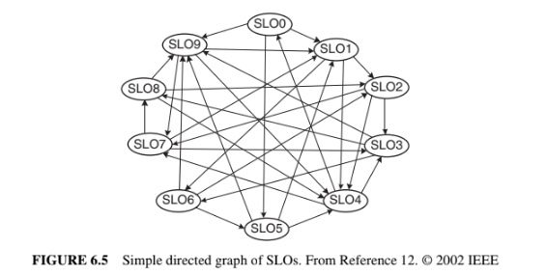
Impact Analysis Process
Each SLO represents a software artifact connected to other artifacts. The artifacts can be arbitrary entities, ranging from a requirement of the entire system to the definition of a variable.

Slide 14
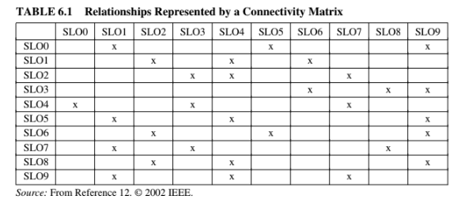
Impact Analysis Process

Slide 15
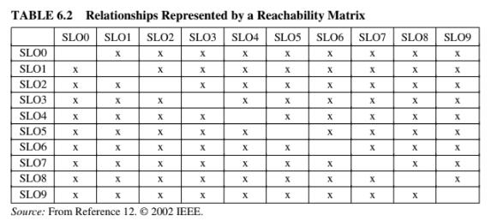
Impact Analysis Process

Slide 16
Dependency based Impact Analysis
https://www.apriorit.com/qa-blog/252-impact-analysis

Slide 17
Dependency-based Impact Analysis
Dependency-based impact analysis techniques identify the impact of changes by analyzing syntactic dependencies, because syntactic dependencies are likely to cause semantic dependencies.
Two traditional impact analysis techniques are explained in this section. The first technique is based on call graph, whereas the second one is based on dependency graph
Call Graph:
A call graph is a directed graph in which a node represents a function, a component, or a method, and an edge between two nodes A and B means that A may invoke B.

Slide 18
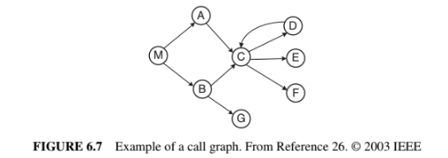
Dependency-based Impact Analysis
Call Graph:
Let P be a program, G be the call graph obtained from P, and p be some procedure in P.
A key assumption in the call-graph-based technique is that some change in p has the potential to impact changes in all nodes reachable from p in G.

Slide 19
Dependency-based Impact Analysis
Call Graph:
Call-graph-based approach to impact analysis suffers from many disadvantages as follows:
A call graph represents the potential calls by a single procedure, while ignoring the dynamic aspects. Consequently, impact analysis based on call graphs can produce an imprecise impact set. For example, in Figure 6.7, one cannot determine the conditions that cause impacts of changes to propagate from M to other procedures.
Generally, a call graph captures no information flowing via returns. Therefore, impact propagations due to procedure returns are not captured in the call-graph- based technique. Suppose that in Figure 6.7, D is modified and control returns to C. Now, following the return to C, it cannot be inferred whether impacts of changing E propagates into none, both, A, or B.

Slide 20
Dependency-based Impact Analysis
Call Graph:
To address the aforementioned issues, Law and Rothermel defined a technique called path-based dynamic impact analysis that uses whole path profiling to estimate the effects of changes.
In this approach, if a procedure p is changed, then one considers the impact that is likely to propagate along those executable paths that are seen to be passing through p. As a result, any procedure, that is invoked after p but still appears on the call stack after p terminates, is assumed to be potentially impacted.

Slide 21

Dependency-based Impact Analysis
Call Graph:
Let us consider an execution trace as shown in Figure 6.8. The trace corresponds to a program whose call graph is shown in Figure 6.7. In the figure, r and x represent function returns and program exits, respectively. Let procedure E be modified. The impact of the modification with respect to the given trace is computed by forward searching in the trace to find: (i) procedures that are indirectly or directly invoked by E; and (ii) procedures that are invoked after E terminates. One can identify the procedures into which E returns by performing backward search in the given trace. For example, in the given trace, E does not invoke other entities, but it returns into M, A, and C. Due to a modification in E, the set of potentially impacted procedures is {M, A,C, E}.

Slide 22
Dependency-based Impact Analysis
Program Dependency Graph:
In the program dependency graph (PDG) of a program:
(i) each simple statement is represented by a node, also called a vertex; and
(ii) each predicate expression is represented by a node.
There are two types of edges in a PDG: data dependency edges and control dependency edges.
In the following figure Data dependencies are shown as solid edges, whereas control dependencies are shown as dashed edges.

Slide 23
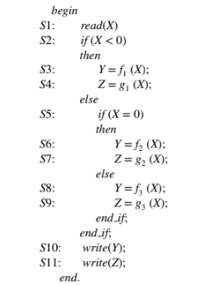
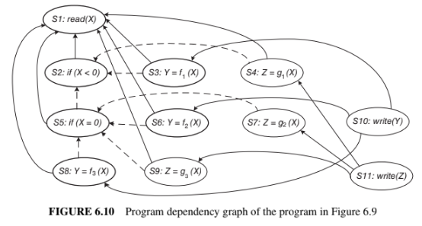
Dependency-based Impact Analysis
Program Dependency Graph:

Slide 24
Dependency-based Impact Analysis
Static Program Slice:
A static program slice is identified from a PDG as follows:
(i) for a variable var at node n, identify all reaching definitions of var; and
(ii) find all nodes in the PDG which are reachable from those nodes.
The visited nodes in the traversal process constitute the desired slice.
Consider the program in Figure 6.9 and variable Y at S10. First, find all the reaching definitions of Y at node S10—and the answer is the set of nodes {S3, S6, and S8}. Next, find the set of all nodes which are reachable from {S3, S6, and S8}—and the answer is the set {S1, S2, S3, S5, S6, S8}.

Slide 25
Dependency-based Impact Analysis
Program Dependency Graph:

Slide 26
Dependency-based Impact Analysis
Dynamic Program Slice:
Referring to the static slice example discussed above, only one of the three assignment statements, S3, S6, or S8, may be executed for any input value of X. Consider the input value −1 for the variable X. For −1 as the value of X, only S3 is executed. Therefore, with respect to variable Y at S10, the dynamic slice will contain only {S1, S2, and S3}.
For −1 as the value of X, if the value of Y is incorrect at S10, one can infer that either fi is erroneous at S3 or the “if” condition at S2 is incorrect. Thus, a dynamic slice is more useful in localizing the defect than the static slice.
A simple way to finding dynamic slices is as follows:
(i) for the current test, mark the executed nodes in the PDG; and
(ii) traverse the marked nodes in the graph.

Slide 27
Impact Analysis Evaluation
Göçmen, I.S., Cezayir, A.S. and Tüzün, E., 2025. Enhanced code reviews using pull request based change impact analysis. Empirical Software Engineering, 30(3), p.64.

